Slide 1

FORAGE – DATA SCIENCE INTERNSHIP
Prepared by
Young Irivboje, Ph.D.
Data scientist

Slide 2
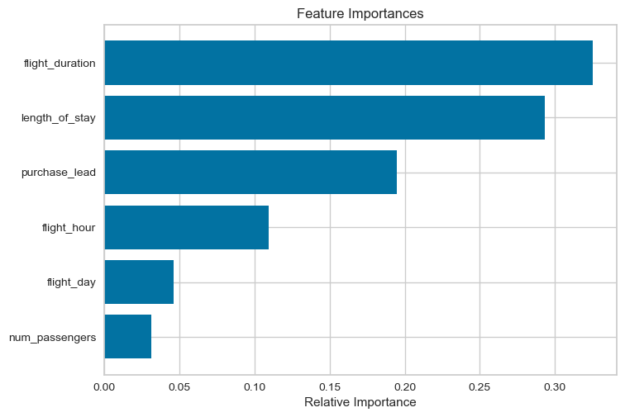
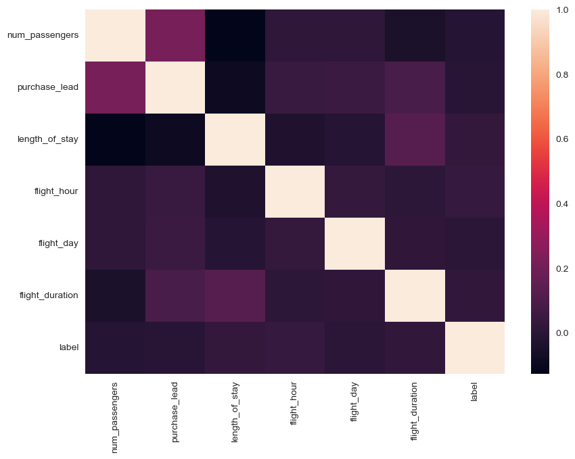
PREDICTIVE MODEL
Classification Report
Model Accuracy – 67%
Precision Recall f1-score
0 63% 58% 60%
62% 67% 64%
Test Accuracy – 62%
The dataset was highly imbalanced (0s – 42706 and 1s -7476), which greatly impacted its accuracy. We balanced the dataset by the same number of classes (7400 each) and set some hyperparameters for fitting.
Important Features
Correlation Matrix

